Slide 1
Kneejerk, Intuition, Cognition and Hindsight Bias
Brian Peacock, Stella Ng, Tan Kay Chuan, Lucas Tan, Pang Jin Zhou
National University of Singapore
SIM University
August 2013

Slide 2
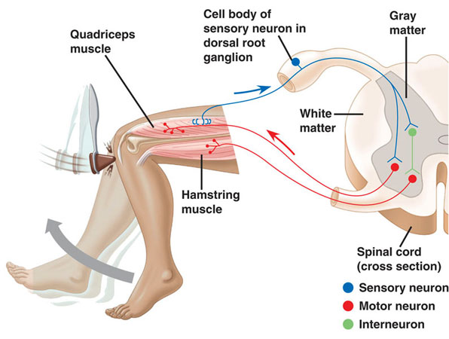
Knee Jerk
Just a few milliseconds
(Nerve impulses travel up to 100 m / sec)

Slide 3
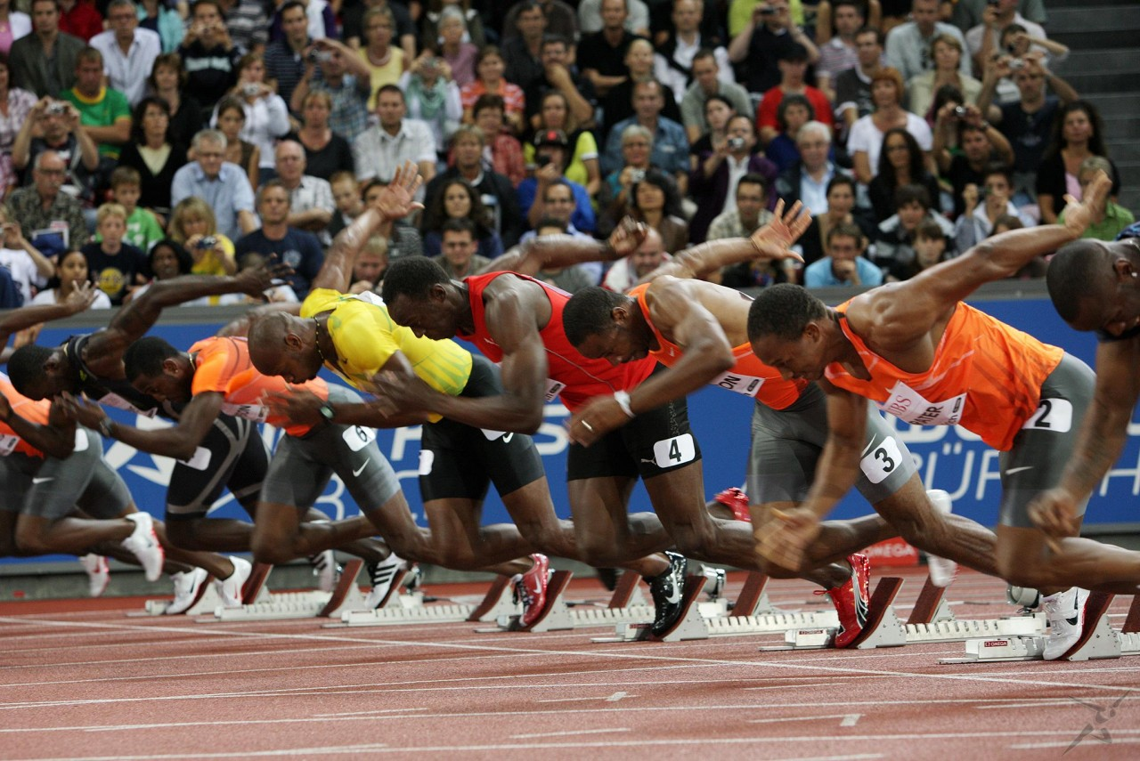
Ready Set Go! False Start!
100 milliseconds

Slide 4
Reaction Time Donders (1868)
In 1868, the Dutch physiologist and ophthalmologist F. C. Donders suggested that such mental processes as sensory discrimination, perceptual identification, and motor selection might occur serially, each consuming a certain amount of time. If so, wrote Donders, “interposing into the process some new components of mental action would reveal the time required for the interposed item” (Donders, 1868/1969, p. 418). In other words, if one could devise a pair of tasks differing only in that one required an extra mental process, then the difference in reaction time (RT) to the two tasks would be an estimate of the duration of the extra mental process.
Thinking Takes Time

Slide 5
Hick’s Law
Hick's law, named after British psychologist William Edmund Hick, or the Hick–Hyman Law (for Ray Hyman), describes the time it takes for a person to make a decision as a result of the possible choices he or she has; that is, increasing the number of choices will increase the decision time logarithmically. The Hick–Hyman law assesses cognitive information capacity in choice reaction experiments. The amount of time taken to process a certain amount of bits in the Hick–Hyman law is known as the rate of gain of information. Given n equally probable choices, the average reaction time T required to choose among them is approximately
Thinking Takes Time

Slide 6
Bayes’ Theory
p_{E}(H) = p(H)*p_{H}(wE) / p(H)*p_{H}(wE) + p(H’)*p_{H’}(wE)
Decision making (Hypothesis evaluation) converges as more data becomes available
But people are sub Bayesian because data acquisition takes time and some evidence sources are weighted more highly than others
Most sports decision making opportunities are time constrained

Slide 7
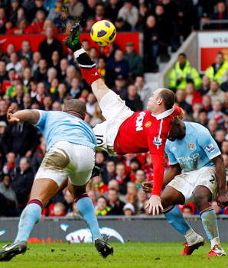
The Goal of the Century
Decisions, Skills, Outcome

Slide 8
Decision and Response Times
 |  |  |  |  | Speed
k/hr | 20 | 40 | 60 | 80 | 100 | 120 | 140 | 160 | 180 | 200
m/sec | 5.6 | 11.1 | 16.7 | 22.2 | 27.8 | 33.3 | 38.9 | 44.4 | 50.0 | 55.6
Distance (meters)
10 | 1.800 | 0.900 | 0.600 | 0.450 | 0.360 | 0.300 | 0.257 | 0.225 | 0.200 | 0.180
15 | 2.700 | 1.350 | 0.900 | 0.675 | 0.540 | 0.450 | 0.386 | 0.338 | 0.300 | 0.270
20 | 3.600 | 1.800 | 1.200 | 0.900 | 0.720 | 0.600 | 0.514 | 0.450 | 0.400 | 0.360
25 | 4.500 | 2.250 | 1.500 | 1.125 | 0.900 | 0.750 | 0.643 | 0.563 | 0.500 | 0.450
30 | 5.400 | 2.700 | 1.800 | 1.350 | 1.080 | 0.900 | 0.771 | 0.675 | 0.600 | 0.540
35 | 6.300 | 3.150 | 2.100 | 1.575 | 1.260 | 1.050 | 0.900 | 0.788 | 0.700 | 0.630
40 | 7.200 | 3.600 | 2.400 | 1.800 | 1.440 | 1.200 | 1.029 | 0.900 | 0.800 | 0.720
45 | 8.100 | 4.050 | 2.700 | 2.025 | 1.620 | 1.350 | 1.157 | 1.013 | 0.900 | 0.810
50 | 9.000 | 4.500 | 3.000 | 2.250 | 1.800 | 1.500 | 1.286 | 1.125 | 1.000 | 0.900
 |  |  |  |  | Time in seconds

Slide 9
Hindsight: Intuition or Impulse
It all depends on the outcome
Successful outcome – “Intuition”
Unsuccessful outcome – “Impulse”
Hindsight
Retrospective reconstruction of the facts

Slide 10
The Problem of Operational Limited Capacity
Experience
Anticipation
Prejudice
Habit
Long Term
Memory
Execution
Attention
Operational Memory
Decisions
External Information
Limited capacity
Limited information

Slide 11
Fuzzy Awareness
Knowledge
Strategy
Tactics
Long Term Memory
Noise
Planning
Mental
Simulation
Expertise
Distraction
Operational Memory
Attending
Learning
Deciding
Situation Awareness
Controlling
Adapting
Perceiving
Feedback
Predicting
Responding
Understanding

Slide 12
A (Kano) Model of a Game Player
Size
Strength
Speed
Stamina
Outcome
Performance
Hindsight
Must Have
Style
Behavior
Situation Awareness
Perception
Understanding Prediction
Skill
Execution
Excitement
Decision Making
Sensitivity
Selectivity
Strategy
The More the Better

Slide 13
Measurement
It is Easy to measure Size, Strength, Speed and Stamina and Skills
Everybody measures Outcomes
It is difficult to measure Situation Awareness and Cognitive / Decision Processes
Often we are biased by Style
Size
Strength
Speed
Stamina
Must Have
Outcome
Performance
Hindsight
Style
Behavior
Situation Awareness
Perception
Understanding Prediction
Skill
Execution
Excitement
Decision Making
Sensitivity
Selectivity
Strategy
The More the Better

Slide 14
Mental Workload and Situation Awareness
Information Load * Stress
Time * Expertise
Mental Workload =
Situation Awareness =
Perception + Understanding + Prediction
Situation Awareness =
1 / Mental Workload

Slide 15
Attention, Signal Detection and Performance
Attention =
Signal Size and Salience + Personal Preparedness - Noise
Signal Detection = Attention + Perception + Understanding
Performance = Attention + Detection + Personal Preparedness

Slide 16
Situation Awareness Model SA is a widely used method of describing human performance in complex situations such as aviation and process plant operation
Context
Responses
Decisions
Situation Awareness
Stage 1
Perception
Stage 2
Understanding
Stage 3
Projection
16

Slide 17
Hindsight Bias
“Monday Morning Quarterback”
Sports produce numerous statistics of outcomes:
Goals, points, assists, blocks etc. etc. etc.
Coaches analyze behaviors
Movements and Style
Difficult to analyze awareness and decisions objectively
Analysis is inevitably biased by outcomes
Analysis often implies cognitive processes

Slide 18
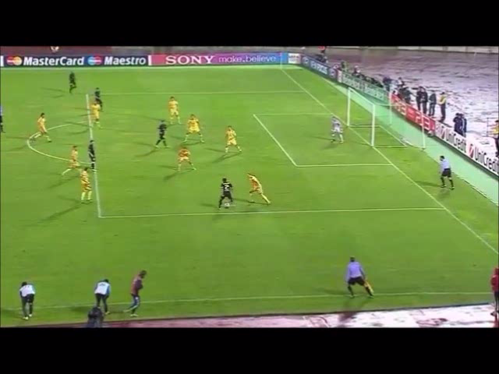
Soccer Decision Making
20 Scenarios with varying complexity, more than 100 subjects
Hold, Pass, Dribble or Shoot
Three snapshots – before action, after action, after outcome
Descriptions using Kano model – implied cognitive processes

Slide 19
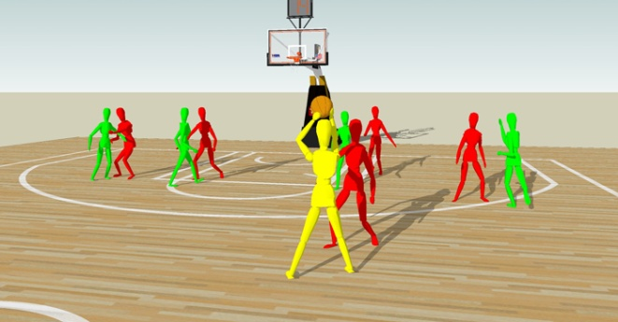
Basketball Decision Making
20 Scenarios with varying difficulty using manikins, > 100 subjects
Hold, Dribble, Pass, Shoot
Coach / Player observations of best choices –Situation awareness
Correlations between observer decisions and objective performance measures

Slide 20
Soccer Refereeing
Replay
20 Scenarios with varying decision difficulty, > 50 subjects
Foul / No Foul; Card / No card
Replay caused changed decisions, especially among less experienced players
The Three Step Rule – Buying Time

Slide 21
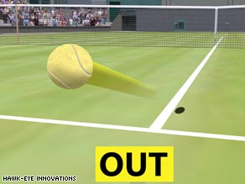
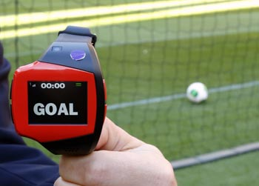
Technology Aided Decisions For Referees
Tennis
Football

Slide 22
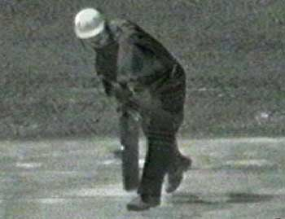
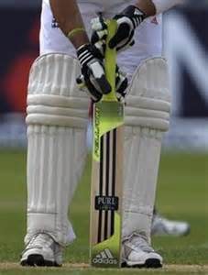
Hot Spot (LBW or Caught Behind?)
Technology Aided Decisions

Slide 23
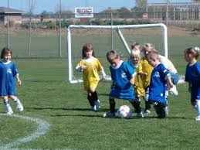
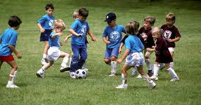
Soccer Coaching
Young children pay attention only to the ball and are less aware of their surroundings
Stop the action and probe the players’ awareness of the situation and their options

Slide 24
SAGAT and SART
Situation Awareness Assessment Tools
Used in snapshots of sequential development of a scenario
Convenient to use in Simulations
Explains subjects ability to
Perceive, Comprehend, Predict

Slide 25
Coaches should analyze and train the cognitive functions
Size
Strength
Speed
Stamina
Must Have
Outcome
Performance
Hindsight
Style
Behavior
Situation Awareness
Perception
Understanding Prediction
Skill
Execution
Excitement
Decision Making
Sensitivity
Selectivity
Strategy
The More the Better

Slide 26
An Outcome of Training
If the only tool you have is a hammer then all problems look like a nail!
Most game players have preferred actions
Many coaches have preferred strategies
Many players do not learn from experience and reflection
Coaches must give players the opportunity to analyze and reflect on situations and decisions, and avoid hindsight bias as far as is possible

Slide 27
Conclusions
Success at sports needs both bodies and brains
Analysis of cognitive contributions is often affected by Hindsight Bias
Analysis, selection and coaching will benefit from attention to Situation Awareness and Decision Processes

